Slide 1
20XD14 -Problem Solving and C Programming
File Processing

Slide 2
Outline
Introduction
Data Hierarchy
Files and streams
Declaration of file pointer
Opening and closing a file
Formatted and unformatted file I/O functions
Random access file functions
Command line arguments

Slide 3
Background
Console oriented I/O functions use keyboard as input device and monitor as output device
I/O functions - printf(), scanf(), getchar(), putchar(), gets(), puts()
Problems
1. Entire data is lost when either the program is terminated or the computer is turned off.
2. When the volume of data to be entered is large, it takes a lot of time to enter the data.
3. If user makes a mistake while entering data, whole data has to be re-entered.
Solution: File

Slide 4
Introduction
Storage of data in variables and arrays is temporary—such data is lost when a program terminates
Files are used for permanent retention of data
Computers store files on secondary storage devices, especially disk storage devices
A file is a repository of data that is stored in a permanent storage media, mainly in secondary memory
Files are not only used for storing data, programs are also stored in files
A named collection of data, stored in secondary storage
Examples : Records of all employees in an organization

Slide 5
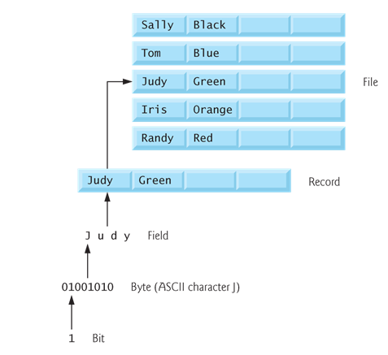
Data Hierarchy
A record is a group of related fields
A file is a group of related records
How is a file stored?
Stored as sequence of bytes, logically contiguous (may not be physically contiguous on disk)

Slide 6

Files and Streams
C views each file simply as a sequential stream of bytes
Each file ends either with an end-of-file marker or at a specific byte number recorded in a system-maintained, administrative data structure
The last byte of a file contains the end-of-file character (EOF), with ASCII code 1A (hex)
While reading a text file, the EOF character can be checked to know the end

Slide 7
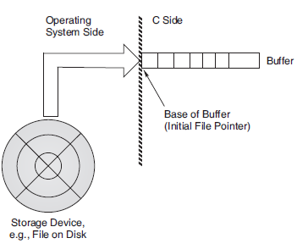
File Streams in C
Streams provide communication channels between files and programs

Slide 8
Stream I/O
Stream I/O uses some temporary storage area, called buffer, for reading from or writing data to a file
Buffer is a block of memory used for temporary storage of data being written to and read from the file
The buffer associated with a file stream serves as an interface between the stream (which is character-oriented) and the disk hardware (which is block-oriented)
As the program writes data to the stream, the data is saved in the buffer until it is full, and then the entire contents of the buffer are written, as a block, to the disk
A similar process takes place when reading data from a disk file
Note: The creation and operation of the buffer are handled by the operating system and are entirely automatic
A stream is linked to a file while using an open operation
A stream is disassociated from a file while using a close operation

Slide 9
Files
Two kinds of files
  Text :: contains ASCII codes only
    C Programs
  Binary :: can contain non-ASCII characters
    Image, audio, video, executable, etc.
    To check the end of file here, the file size value (also stored on disk) needs to be checked
According to the data accessing, files are classified into
  Sequential access files
  Random access files

Slide 10
Text Files
These are the simplest files a user can create when dealing with file handling in C
A text file stores information in the form of ASCII characters internally, but when we open the text file, we would find the content of the text readable to humans
Hence, it is safe to say that text files are simple to use and access
But since it is easily readable, it does not provide any security of information
Moreover, it consumes large storage space
For example:
  For example, given the number 12345, we could store it as individual characters 1, 2, 3, 4, and 5, using one byte for each character in text files:
  00110001 00110010 00110011 00110100 00110101

Slide 11
Binary Files
Alternatively, we could store the number 12345 as a four-byte integer in binary files
  00111001 00110000 00000000 00000000
A binary file stores information in the form of the binary number system (0’s and 1’s) and hence occupies less storage space
In simple words, it stores information in the same way as the information is held in computer memory
Therefore, it proves to be much easier to access
It overcomes the drawback offered by text files
Since it is not readable to humans, the information is more secure
Hence, it is safe to say that binary files prove to be the best way to store information in a data file

Slide 12
Text vs Binary Files
Text files and binary files both represent bytes but text files differ from binary files in that the bytes are understood to represent characters
The mapping of bytes to characters is done consistently over the file using a certain character encoding technique(that determines how the characters are interpreted and what characters can be displayed)
With binary files there is no implicit convention on character encoding
The input and output operations in the binary files takes less time as compared to the text files because no conversion has to be take place
However the data written using binary file system is not very portable because size of data type and byte order may be different on different machines
In text format , these problems do not raise so it is considered more portable

Slide 13
Types of Files
According to the data accessing, files are classified into
  Sequential access files
  Random access files
  Sequential File: In this type of files data is kept in sequential order if we want to read the last record of the file, we need to read all records before that record so it takes more time.
  Random access Files: In this type of files data can be read and modified randomly. If we want to read the last record we can read it directly. It takes less time when compared to sequential file.

Slide 14
Using Files in C
To use a file, four essential actions should to be carried out
These are
  Declare a file pointer variable
  Open a file using the fopen() function
  Process the file using suitable functions
  Close the file using the fclose() function

Slide 15
Declaration of File Pointer
Because a number of different files may be used in a program, when reading or writing, the type of file that is to be used must be specified.
This is accomplished by using a variable called a file pointer, a pointer variable that points to a structure FILE
FILE is a structure declared in stdio.h
The members of the FILE structure are used by the program in various file access operations
For each file that is to be opened, a pointer to type FILE must be declared

Slide 16
Declaration of File Pointer
When the function fopen() is called, that function creates an instance of the FILE structure and returns a pointer to that structure
This pointer is used in all subsequent operations on the file
The syntax for declaring file pointer is as follows
FILE *file_pointer_name;
Example
  FILE *fp1;
  FILE *fp2;
  FILE *fp3, *fp4;

Slide 17
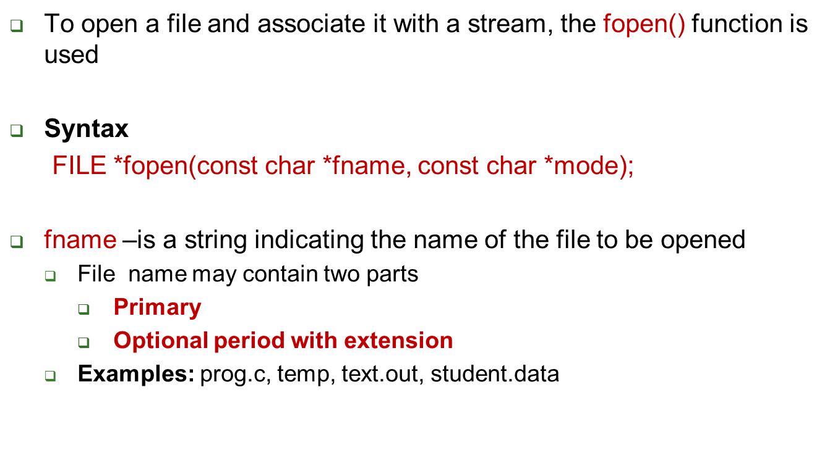
Opening a File
Note: Any number of files can be opened and used at a time

Slide 18
Opening a File
The second argument is to specify the mode of file opening. There are five file opening modes in C
It specifies what processing is to be done with the file - i.e read, write, append
File Opening Modes
r - Opens an existing text file for reading purpose
w - Opens a text file for writing. If it does not exist, then a new file is created. Here your program will start writing content from the beginning of the file
a - Opens a text file for writing in appending mode. If it does not exist, then a new file is created. Here your program will start appending content in the existing file content

Slide 19
Opening a File
r+ - Opens a text file for both reading and writing
w+ - Opens a text file for both reading and writing. It first truncates the file to zero length if it exists, otherwise creates a file if it does not exist
a+ - Opens a text file for both reading and writing. It creates the file if it does not exist. The reading will start from the beginning but writing can only be appended
For Binary files, use the following modes
  rb
  Wb
  ab
  r+b (or) rb+
  w+b (or) wb+
  a+b (or) ab+

Slide 20
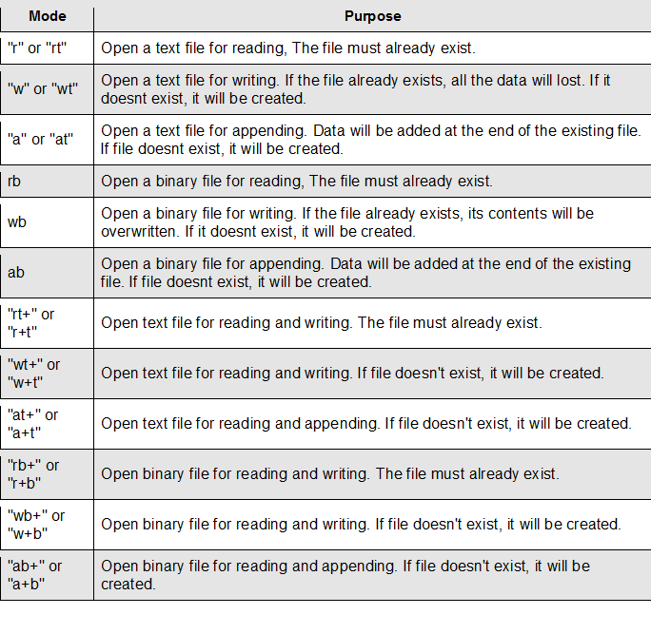
File Open Modes

Slide 21
Opening a File
Return value of fopen()
  The function returns a pointer to FILE, on success
  NULL is returned, on failure
Example
  FILE *fp;
  fp = fopen(“data.dat”,“w”);
fopen() requires two parameters - both are strings
char filename[80];
FILE *fp;
printf(“Enter the filename to be opened”);
gets(filename);
fp = fopen(filename,“w”);

Slide 22
Opening a File
Checking the Return value of fopen()
The fopen() function returns a FILE *, which is a pointer to structure FILE, that can then be used to access the file
When the file cannot be opened due to reasons described below, fopen() will return NULL
  Use of an invalid filename
  Attempt to open a file in a non-existent directory or on a non-existent disk drive
  Attempt to open a non-existent fi le in mode r

Slide 23
Opening a File
Checking the Return value of fopen()
fp = fopen(“data.dat”,“r”);
if(fp == NULL)
{ printf(“Can not open data.dat\n”);
exit(1);
}
Alternatively, the above segment of code can be written as follows
FILE *fp;
if((fp = fopen(“data.dat”, “r”)) ==NULL)
{
printf(“Can not open data.dat\n”);
exit(1);
}
Note : to use exit(1), include the header file #include <stdlib.h>

Slide 24
Closing the file
After completing the processing on the file, the file (both text and binary) must be closed using the fclose() function
Syntax
int fclose(FILE *fp);
The argument fp is the FILE pointer associated with the stream;
fclose() returns 0 on success, -1 on error
To close all the files used in a program, use
fcloseall();
Note : When a program terminates (either by reaching the end of main() or by executing the exit() function), all streams are automatically flushed and closed
When a file is closed, the file’s buffer is flushed or written to the file

Slide 25
Closing the file
#include <stdio.h>
int main () {
FILE *fp;
fp = fopen("file.txt", "w");
………..
fclose(fp);
return(0);
}
#include <stdio.h>
int main()
{
FILE *stream1, *stream2;
if ((stream1 = fopen("ch1.txt","r+")) != NULL &&
(stream2 = fopen("ch2.txt","r+")) != NULL)
.
.
.
fcloseall(); // fclose(stream1); fclose(stream2);
}
}

Slide 26
I/O operations on files
C provides several different functions for reading/writing
Unformatted I/O functions
  getc () (or) fgetc ()
  putc () (or) fputc ()
  fgets()
  fputs()
  fread()
  fwrite()
Formatted I/O functions
  fscanf()
  fprintf()

Slide 27
Unformatted I/O Functions
fputc() Function
The library function putc() (or fputc()) writes a single character to a specified stream
int putc(int ch, FILE *fp);
#include <stdio.h>
int main () {
FILE *fp;
int ch;
fp = fopen("file.txt", "w+");
for( ch = 65 ; ch <= 90; ch++ ) {
fputc(ch, fp);
}
fclose(fp);
return(0);
}
file.txt in the current directory will have following content
ABCDEFGHIJKLMNOPQRSTUVWXYZ

Slide 28
Unformatted I/O Functions
getc() function
The functions getc() and fgetc() are identical and can be used interchangeably
Syntax : int getc(FILE *fp);
#include <stdio.h>
int main () {
FILE *fp;
int c;
fp = fopen("file.txt","r");
while(1) {
c = fgetc(fp);
if( feof(fp) ) {
break ;
}
printf("%c", c);
}
fclose(fp);
return(0); }
Output
ABCDEFGHIJKLMNOPQRSTUVWXYZ

Slide 29
Example - 2
# include <stdio.h>
int main( )
{
FILE *fp ;
char c ;
printf( "Opening the file test.c in read mode" ) ;
fp = fopen ( "test.c", "r" ) ; // opening an existing file
if ( fp == NULL )
{
printf ( "Could not open file test.c" ) ;
return 1;
}
printf( "Reading the file test.c" ) ;
while ( 1 )
{
c = fgetc ( fp ) ; // reading the file
if ( c == EOF )
break ;
printf ( "%c", c ) ;
}
printf("Closing the file test.c") ;
fclose ( fp ) ; // Closing the file
return 0;
}

Slide 30
EOF Vs feof( )
Main difference is EOF is a value to compare upon characters to check whether end of a stream has reached and feof is a function call to check a file pointer has reached end of that file
EOF
  EOF is a condition in a computer operating system where no more data can be read from a data sources
  It is mostly used in character reading functions like getc() or getch() or getchar()
  These functions will return a value EOF to indicate that an end-of-file condition has occurred. The value of EOF is -1
feof()
  The function feof(FILE *stream) tests the end-of-file indicator for the stream pointed to by stream, returning nonzero if it is set

Slide 31
Unformatted I/O Functions
fgets() Function – to read a line of text from a file
Syntax : char *fgets(char *str, int n, FILE *fp);
This function stops reading when any of the following conditions are true
It has read n – 1 bytes (one character is reserved for the null-terminator)
It encounters a new-line character (a line-feed in the compiler is placed here)
It reaches the end of file
A read error occurs
fgets() automatically appends a null-terminator to the data read

Slide 32
Unformatted I/O Functions
char *fgets(char *str, int n, FILE *fp);
Parameters
  str: array of characters to be read from the file
  n : the maximum length that the fgets function can read
  stream : the pointer to a FILE object, or simply say, file pointer that holds the file address and the operation mode
fputs() function is used to write string(array of characters) to the file
Syntax : int fputs(const char *str, FILE *stream)
  str − is an array containing the null-terminated sequence of characters to be written
  stream − is the pointer to a FILE object that identifies the stream where the string is to be written

Slide 33
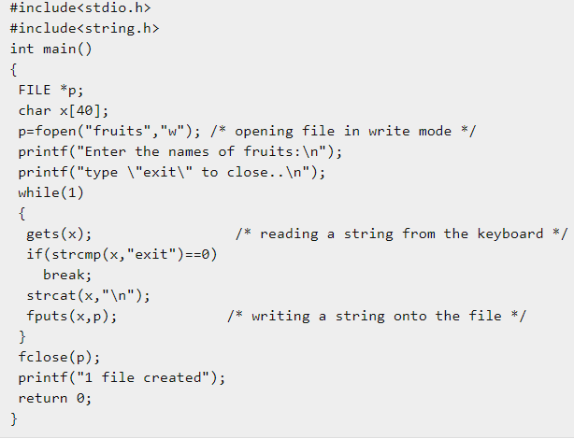
Example – fputs( )
Execution
Enter the names of fruits:
exit to close..
apple
Goa
grapes
jackfruit
exit

Slide 34
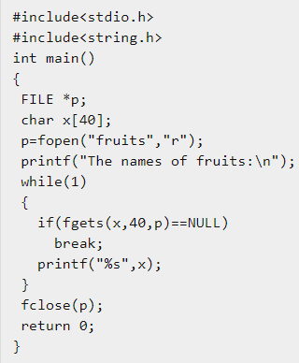
Example – fgets( )
Execution:
The names of fruits:
apple
Goa
grapes
jack fruit

Slide 35
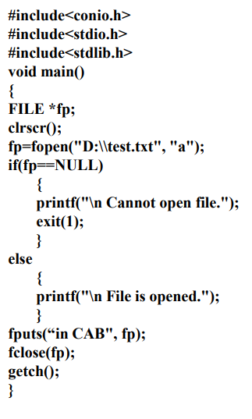
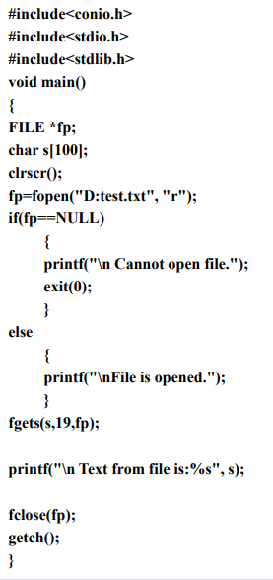

Slide 36
Formatted I/O Functions
Syntax : fscanf()
int fscanf(FILE *fp, const char *format [, argument, ...] );
The fscanf() function is used to read formatted input from the file
Instead of reading data from the standard input it reads the data from the file
On success, this function returns the number of values read and on error or end of the file it returns EOF or -1
Syntax : fprintf()
int fprintf(FILE *fp, const char *format [, argument, ...] );
Instead of writing data to the console, it writes formatted data into the file
On success, it returns the total number of characters written to the file. On error, it returns EOF

Slide 37
Formatted I/O Functions
// Example : fscanf()
#include<stdio.h>
#include<stdlib.h>
int main()
{
FILE *fp;
char name[50];
int roll_no, i, n;
float marks;
fp = fopen("records.txt", "w");
if(fp == NULL)
{
printf("Error opening file\n");
exit(1);
}
printf("Enter the number of records you want to enter: ");
scanf("%d", &n);

Slide 38
Formatted I/O Functions
for(i = 1; i <=n; i++)
{
printf("\nEnter the details of student %d \n\n", i);
printf("Enter name of the student: ");
gets(name);
printf("Enter roll no: ");
scanf("%d", &roll_no);
printf("Enter marks: ");
scanf("%f", &marks);
fprintf(fp, "Name: %s\t\tRoll no: %d\t\tMarks: %.2f\n",
name, roll_no, marks);
}
fclose(fp);
return 0;
}
Name: Tina Roll no: 1 Marks: 45.00
Name: Nina Roll no: 5 Marks: 89.00
Name: Tim Roll no: 2 Marks: 49.00
Name: Jim Roll no: 8 Marks: 41.00
Name: King Roll no: 9 Marks: 59.00
records.txt

Slide 39
Formatted I/O Functions
//Example : fscanf()
#include<stdio.h>
#include<stdlib.h>
int main()
{
FILE *fp;
char name[50];
int roll_no, chars;
float marks;
fp = fopen("records.txt", "r");
if(fp == NULL)
{
printf("Error opening file\n");
exit(1);
}

Slide 40
Formatted I/O Functions
while( fscanf(fp, "Name: %s\t\tRoll no: %d\t\tMarks: %f\n“, name, &roll_no, &marks)
!= EOF )
{
printf("%s\t\t%d\t\t%.2f\n", name, roll_no ,marks);
}
fclose(fp);
return 0;
}
Output:
Name: Tina Roll no: 1 Marks: 45.00
Name: Nina Roll no: 5 Marks: 89.00
Name: Tim Roll no: 2 Marks: 49.00
Name: Jim Roll no: 8 Marks: 41.00
Name: King Roll no: 9 Marks: 59.00

Slide 41
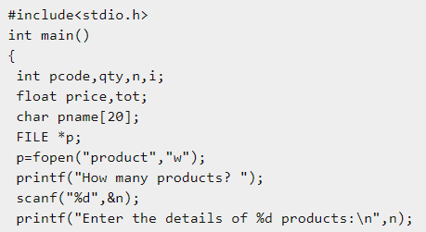
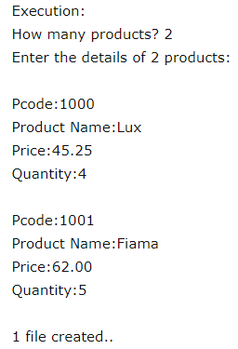
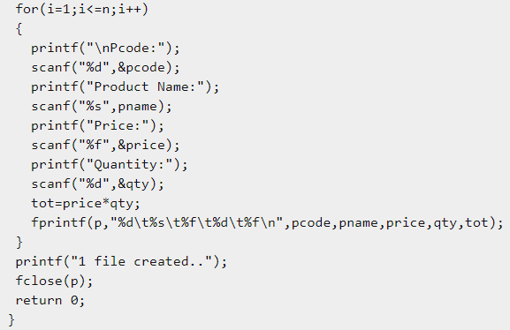
Example 2 : fscanf and fprint

Slide 42
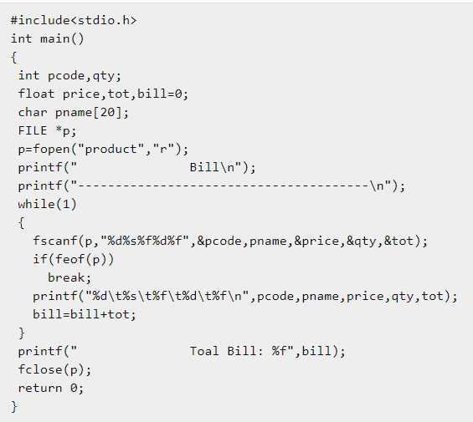
Execution
Bill
—————————————
1000 Lux 45.250000 4 181.000000
1001 Fiama 62.000000 5 310.000000
Toal Bill: 491.000000

Slide 43
Example 3
Detecting the End of a File Using the feof() Function
Can be used for both binary and text files
The feof() function takes a file stream as argument and returns an integer value which specifies if the end of file has been reached
Syntax : int feof(FILE *stream)
The feof() function returns
  nonzero if the end has been reached
  zero otherwise

Slide 44
Example 3
#include<stdio.h>
struct emp
{
char name[10];
int age;
};
int main()
{
struct emp e;
FILE *p,*q;
p = fopen("one.txt", "a");
q = fopen("one.txt", "r");
printf("Enter Name and Age:");
scanf("%s %d", e.name,&e.age);
fprintf(p,"%s %d", e.name,e.age);
fclose(p);
printf("Contents in the files are\n");
do
{
fscanf(q,"%s %d", e.name,&e.age);
printf("%s\t %d\n", e.name,e.age);
}
while(!feof(q));
}

Slide 45
Example - 4
A file named DATA contains a series of integer numbers. Code a program to read these numbers and then write all odd numbers to a file to be called ODD and all even numbers to a file to be called EVEN

Slide 46
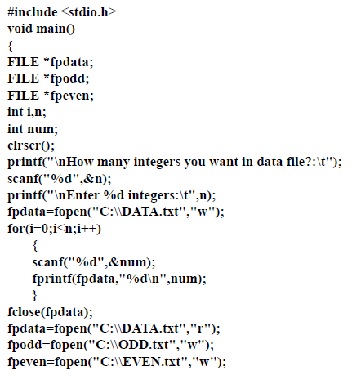

Slide 47
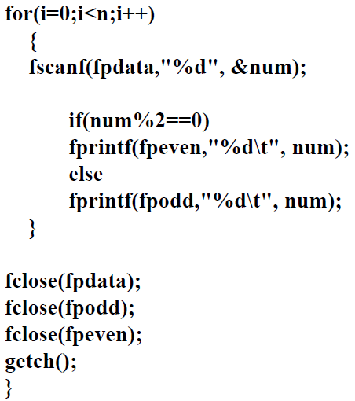

Slide 48
Binary Files
fread() and fwrite() functions
  The fwrite() function is used to write records (sequence of bytes) to the file
  Syntax
  size_t fwrite(const void *ptr, size_t size, size_t nmemb, FILE *stream)
Parameters
  ptr − This is the pointer to the element / array of elements to be written
  size − This is the size in bytes of each element to be written
  nmemb − This is the number of elements, each one with a size of size bytes
  stream − This is the pointer to a FILE object that specifies an output stream
Return Value
  the total number of elements successfully returned as a size_t object, which is an integral data type

Slide 49
Binary Files
fread() - is used to read bytes form the file
Syntax
size_t fread(void *ptr, size_t size, size_t nmemb, FILE *stream)
Parameters
  ptr − This is the pointer to a block of memory with a minimum size of size*nmemb bytes
  size − This is the size in bytes of each element to be read
  nmemb − This is the number of elements, each one with a size of size bytes
  stream − This is the pointer to a FILE object that specifies an input stream
Return Value
  The total number of elements successfully read are returned as a size_t object, which is an integral data type

Slide 50
Example – fwrite( )
for(i=1;i<=n;i++)
{
printf("Name:");
scanf("%s",x.name);
printf("Place:");
scanf("%s",x.place);
printf("Pin code:");
scanf("%ld",&x.pin);
fwrite(&x,sizeof(x),1,p);
}
fclose(p);
printf("1 file created");
return 0;
}
#include<stdio.h>
struct address
{
char name[20];
char place[20];
long int pin;
};
int main()
{
FILE *p;
struct address x;
int n,i;
p=fopen("address","wb");
printf("How many records?");
scanf("%d",&n);
printf("Enter %d records:\n",n);
How many records?2
Enter 2 records:
Name:subbu
Place:Kavali
Pin code:524201
Name:Ramaiah
Place:Ulavapadu
Pin code:523201
1 file created

Slide 51
Example – fread( )
#include<stdio.h>
struct address
{
char name[20];
char place[20];
long int pin;
};
int main()
{
FILE *p;
struct address x;
p=fopen("address","rb");
printf("Rcords of file:\n");
while(1)
{
fread(&x,sizeof(x),1,p);
if(feof(p)!=0)
break;
printf("\n\nName:%s\nPlace:%s\nPin code:%ld",x.name,x.place,x.pin);
}
fclose(p);
return 0;
}
Output
Rcords of file:
Name:subbu
Place:Kavali
Pin code:524201
Name:Ramaiah
Place:Ulavapadu
Pin code:523201

Slide 52
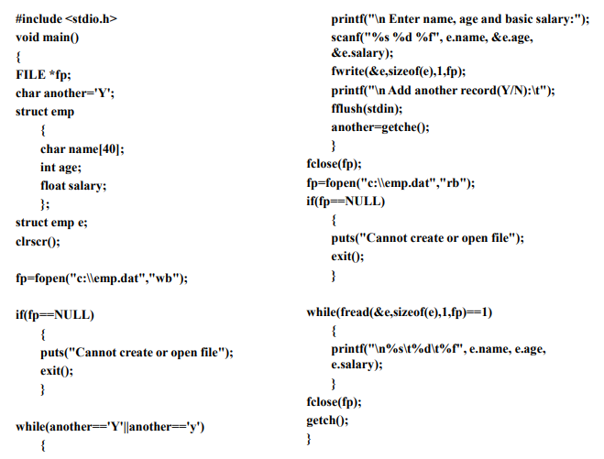

Slide 53
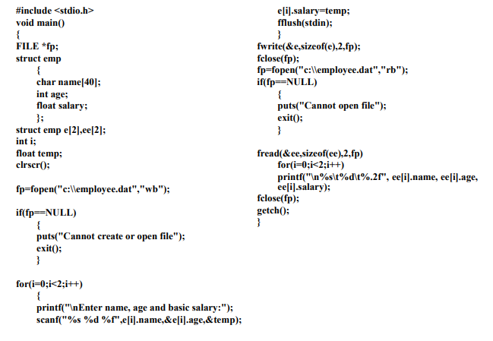

Slide 54
Questions to think
What will happen if you execute following program?
#include<stdio.h>
int main(){
unsigned char c;
FILE *fp;
fp=fopen("test.txt","r");
while((c=fgetc(fp))!=EOF)
printf("%c",c);
fclose(fp);
return 0;
}
//Content of file test.txt
I am reading file test.txt

Slide 55
Questions to think
Output
  It will print the content of file text.txt but it will enter in infinite loop because macro EOF means -1 and at the end of file function fgetc will also return -1 but c can store only unsigned char. It will store any positive number according to rule of cyclic nature of data type. Hence condition will be always true

Slide 56
Standard Streams
When the main function of your program is invoked, it already has three predefined streams open and available for use
These represent the “standard” input and output channels
that have been established for the process
These streams are declared in the header file stdio.h.
FILE * stdin
  The standard input stream, which is the normal source of input for the program
FILE * stdout
  The standard output stream, which is used for normal output from the program
  FILE * stderr
  The standard error stream, which is used for error messages and
  diagnostics issued by the program

Slide 57
Standard Streams
C programming treats all the devices as files
So devices such as the display are addressed in the same way as files and the following three files are automatically opened when a program executes to provide access to the keyboard and screen
Standard File | File Pointer | Device
Standard input | stdin | Keyboard
Standard output | stdout | Screen
Standard error | stderr | Screen

Slide 58
if((fp=fopen("test","r")) == NULL) {
printf("Cannot open file.\n");
exit(1);
}
fscanf(fp, "%s%d", s, &t); /* read from file */
fprintf(stdout, "%s %d", s, t); /* print on screen */
return 0;
}
#include <stdio.h>
#include <stdlib.h>
int main(void)
{
FILE *fp;
char s[80];
int t;
if((fp=fopen("test", "w")) == NULL) {
printf("Cannot open file.\n");
exit(1);
}
printf("Enter a string and a number: ");
fscanf(stdin, "%s%d", s, &t); /* read from keyboard */
fprintf(fp, "%s %d", s, t); /* write to file */
fclose(fp);

Slide 59
fflush( )
fflush() is typically used for output stream only.
Its purpose is to clear (or flush) the output buffer and move the buffered data to console (in case of stdout) or disk (in case of file output stream). Below is its syntax.
fflush(FILE *ostream);
ostream points to an output stream or an update stream in which the most recent operation was not input, the fflush function causes any unwritten data for that stream to be delivered to the host environment to be written to the file; otherwise, the behavior is undefined.

Slide 60
Example of fflush( )
  #include<stdio.h>
  int main()
  {
  char another;
  do
  {
  printf("What is your answer(y/n)?");
  fflush(stdin);
  scanf("%c",&another);
  }while(another=='y');
  }
  If you run this program you will see the program will run till you give 'y' as input. But if you remove the fflush() then the printf() will be executed for 2 times only and then the program will be terminated

Slide 61
Example of fflush( )
When you type 'y' as input and then hit enter key, scanf() assigns it to the variable another and keeps the enter key unread in the keyboard buffer
So when its time to supply input for the second time scanf() reads the enter key from the buffer thinking that user has entered the enter key
To avoid this,we use fflush() to remove or "flush out" any data in the buffer
The argument to fflush() must be the buffer which we want to flush out
Here, we have used "stdin" which means buffer related with standard input device - keyboard

Slide 62
Example : fflush( )
  #include <stdio.h>
  int main()
  {
  char buf[50];
  FILE *fp;
  fp = fopen("test.txt", "r+");
  if (fp)
  {
  fputs("Test data by Fresh2refres", fp);
  fflush(buf); // flushes the buffer to load the data from file
  fgets(buf, 20, fp); // It loads 1st 20 characters from file to buffer
  puts(buf); // It displays buffer data in output screen
  fclose(fp);
  return 0;
  }
  return 1;
  }
fflush() function is used to flush a file or buffer. i.e. it cleans it (making empty) if it has been loaded with any other data already

Slide 63
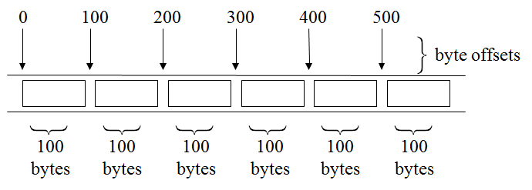
Random Access File Functions
Random access files
  Access individual records without searching through other records
  Instant access to records in a file
  Data can be inserted without destroying other data
  Data previously stored can be updated or deleted without overwriting
Implemented using fixed length records
  Sequential files do not have fixed length records

Slide 64
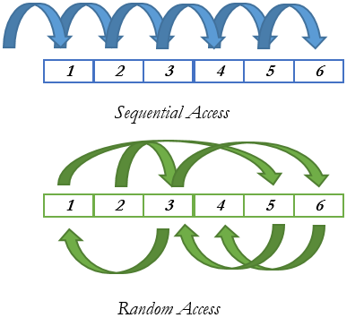
Random Access File Functions
Random means that data can be read from, or written to, any position in a file without reading or writing all the preceding data

Slide 65
Use of file pointer for random access
A file pointer is a pointer to a particular byte in a file
While opening a file in write mode, the file pointer is at the beginning of the file, and whenever we write to a file, the file pointer moves to the end of the data items written so that writing can continue from that point
While opening a file in read mode, the file pointer is at the beginning of the file, and whenever we read from a file, the file pointer moves to the beginning of the next data item so that reading cam continue from that point
While opening a file in append mode, the file pointer is at the end of the existing file, so that new data items can be written from there onwards
If we are able to move the file pointer according as our need, then any data item can be read from a file or written onto a file randomly…………Random Access

Slide 66
Random Access File Functions
For random access to files of records, the following functions are used
  ftell()
  rewind()
  fseek()
ftell() - used to find out the position of file pointer in the file with respect to starting of the file
Syntax
  long ftell (FILE *pointer)
This function is useful in saving the current position of a file, which can be used later in the program

Slide 67
Random Access File Functions
Returns a type long that gives the current file position in bytes from the start of the fi le (the first byte is at position 0)
In case of an error, ftell() returns -1L (a type long –1)
n = ftell(fp);
  This function takes a file pointer as argument and returns a number of type long, that indicates the current position of the file pointer within the file
  Here, n would give the relative offset (in bytes) of the current position. This means that n bytes have already been read (or written)

Slide 68
Random Access File Functions
rewind() – This function takes a file pointer as argument and resets the current position of the file pointer to the start of the file
Syntax : void rewind(FILE *fp);
  The argument fp is the FILE pointer associated with the stream
  After rewind() is called, the file’s position indicator is set to the beginning of the file (byte 0)
  Use rewind() to read some data from a file and to start reading from the beginning of the file again without closing and reopening the file
Note : rewind(fp); n=ftell(fp);
Here, n would be assigned 0, because file position has been set to the start of the file by rewind().
The first byte in the file is numbered as 0, second as 1, and so on

Slide 69
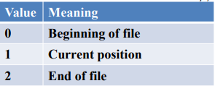
Random Access File Functions
fseek() - This function is used to move the file pointer to a desired position within a file
Syntax : fseek(fp, offset, position);
  where fp is a file pointer, offset is a number or variable data type long, and position is an integer number
  The offset specifies the number of positions (bytes) to be moved from the location specified by position.
  The position can have one of the following 3 values
0 - SEEK_SET
1 - SEEK_CUR
2 - SEEK_END

Slide 70
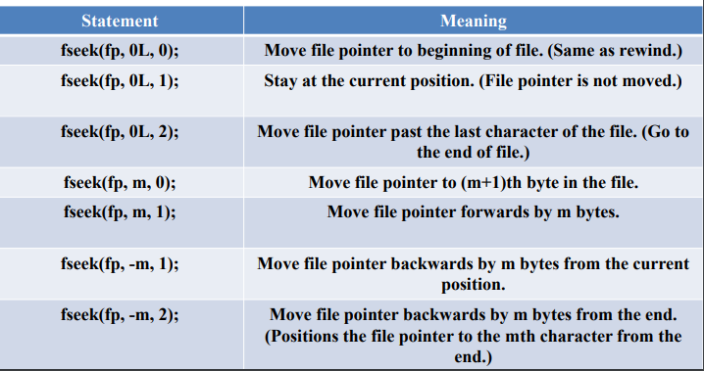
Random Access File Functions
The offset may be positive, meaning move forwards, or negative, meaning move backwards

Slide 71
Random Access File Functions
When the operation is successful, fseek() returns a 0 (zero)
If we attempt to move the file pointer beyond the file boundaries, an error occurs and fseek() returns -1 (minus one)
It is good practice to check whether an error has occurred or not, before proceeding further

Slide 72
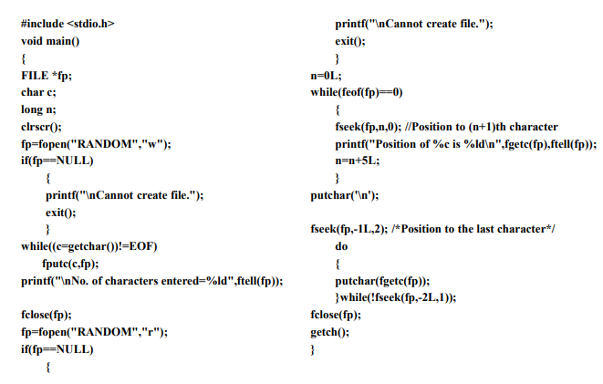

Slide 73
Random Access File Functions
A file called RANDOM is created with the following contents:
Stored Character: A B C … Z
File Pointer Position: 0 1 2 … 25
Then the file is read twice
  At first, we read the contents of every fifth position and print its value with its position on the screen.
  At second, we read the contents of the file from the end and print the same on screen

Slide 74
Example 1
Create a structure named employee having empname, age and salary as its members. Read these information for a number of employees (till user wants) and write these information to a file named employee.txt in C-drive. Finally, the program should be able to search the information of a particular employee by its empname from the file

Slide 75
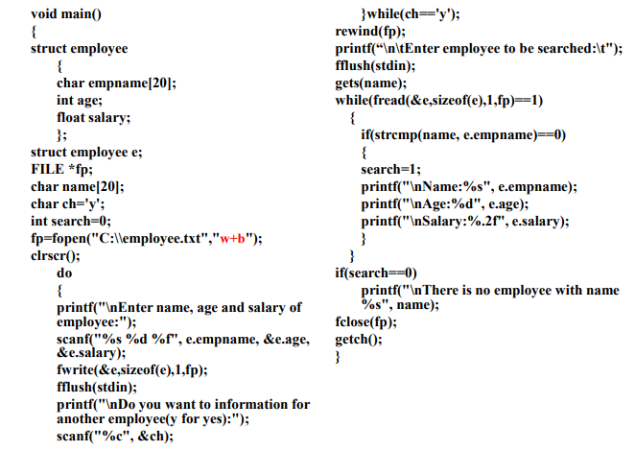

Slide 76
Example 2
Write a program to open a file employee.txt created in above program and edit/modify the details of a particular employee

Slide 77
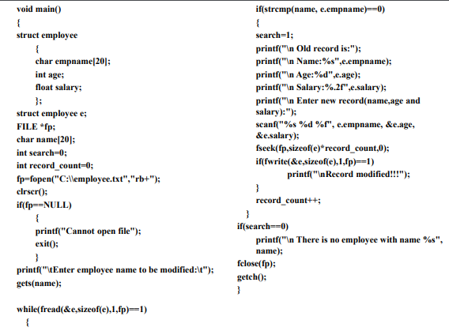

Slide 78
Command Line Arguments
While calling executable file from the command line, we can send other parameters to the program along with the program name
A program can be executed by directly typing a command at the operating system prompt
  $ ./a.out in.dat out.dat
The individual items specified are separated from one another by spaces - First item is the program name
These parameters can be accessed from the main(). To receive the arguments from command line the structure of main() must be changed as
int main(int argc, char *argv[ ])
{ }
Note: variables argc and argv keep track of the items specified in the command line

Slide 79
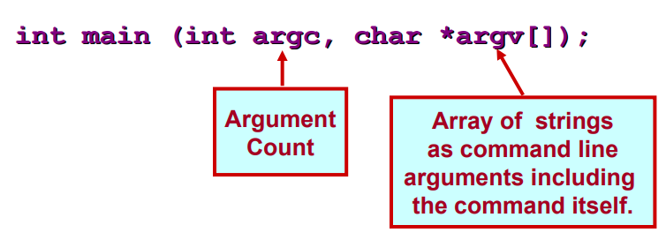
How to Access Command Line Arguments
Command line arguments may be passed by specifying them under main()

Slide 80
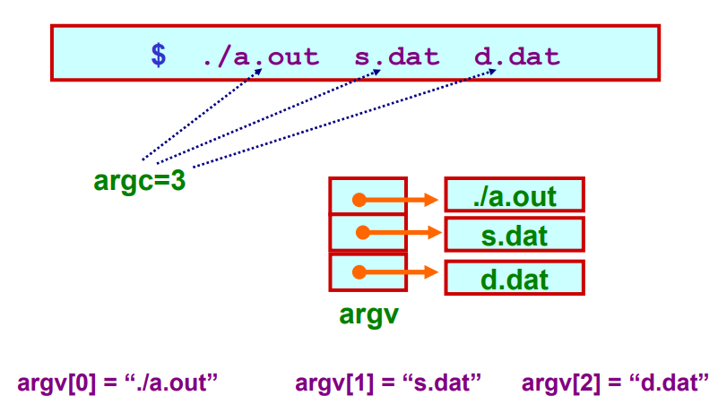
Example

Slide 81
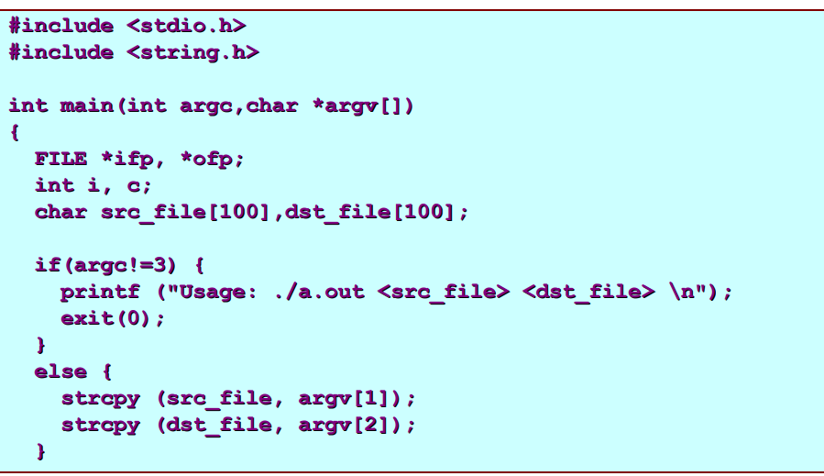
Example: reading command line arguments

Slide 82
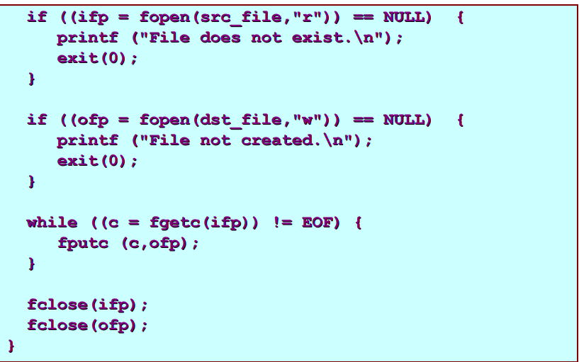
Example: reading command line arguments

Slide 83
Example - 2
#include<stdio.h>
int main(int n, char *x[ ])
{
int i;
printf("Command line arguments are:\n");
for(i=0;i<n;i++)
printf("%s\n", x[i]);
return 0;
}
$./a.out live one day at a time
Command line arguments are:
./a.out
live
one
day
at
a
time

Slide 84

Example: with command-line arguments
Write a program which will take the number of data items, followed by the actual data items on the command line, and print the average
argv[0] = “./a.out”
argv[1] = “6”
argv[2] = “10”
argv[3] = “17”
argv[4] = “35”
argv[5] = “12”
…..

Slide 85
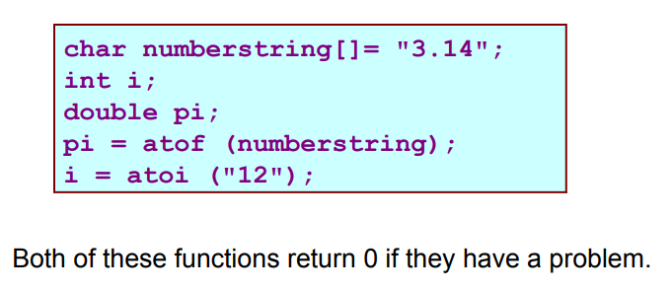
Getting numbers from strings
Once we have got a string with a number in it (either from a file or from the user typing) we can use atoi or atof to convert it to a number
The functions are part of stdlib.h

Slide 86

Command Line Arguments
Note

